Slide 1
Computation 2 Labs Introduction
2023-2024

Slide 2
Computation 2
Deliver the assignments via OnCourse.
Check schedule for delivery dates.
Don’t underestimate the workload:
5 ETCS is 140 hours on average, of which:
~45 hours of labs
~95 hours of reading, finishing labs and exam preparation
The labs are the contact time, so use the lab time to ask questions.

Slide 3
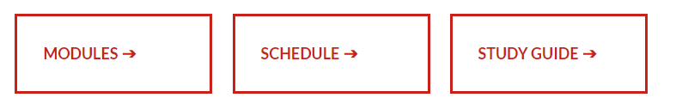
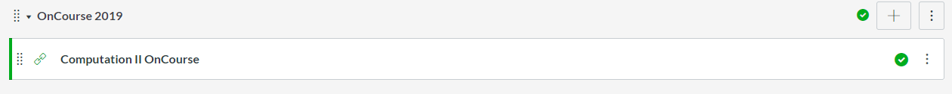
Getting started (Canvas)
Canvas
Announcements
You must always go to OnCourse via the Canvas link
Access OnCourse via modules on Canvas
Schedule (with labs submission deadlines!)
General material
Labs assignments (and submission interface!)

Slide 4
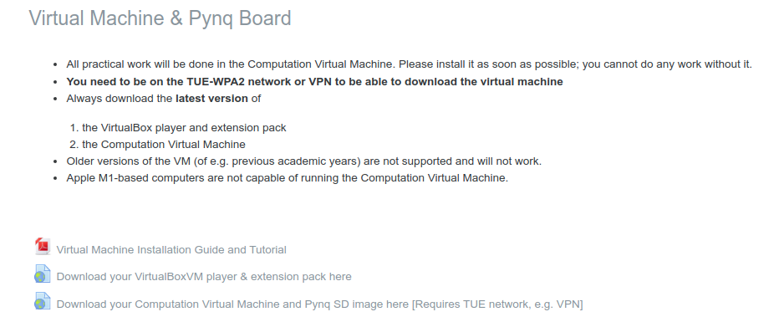
Getting started (OnCourse)
Test your PYNQ-Z2 board
Download VirtualBox https://www.virtualbox.org/wiki/Downloads
Download this year’s VM
Notes:
The patch part is in Lab0

Slide 5
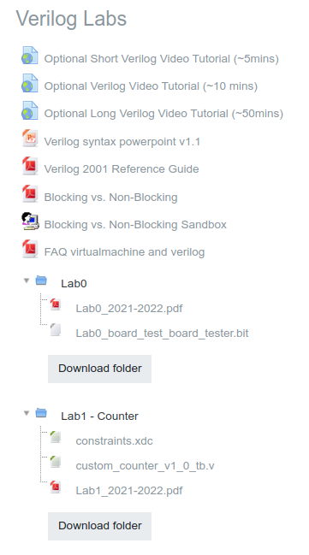
Getting started (OnCourse)
Start the Verilog Labs
Some additional useful resources
Start with Lab 0
Download Lab0_2021-2022.pdf
Follow the instructions to create a new project in Vivado and test your PYNQ board
Then progress to Lab 1
Steeper learning curve than Lab 0.
Students generally report the labs get easier after this one.
Notes:
The patch part is in Lab0

Slide 6
Getting Started
Verilog tutorials:
Online material. Suggestions:
https://www.youtube.com/watch?v=q1QwC3YlHG0 5 min. introduction to Verilog
https://www.youtube.com/watch?v=vVYOV9MP5BA&feature=youtu.be 10 min Verilog basics
http://www.asic-world.com/verilog/veritut.html comprehensive tutorial
https://www.youtube.com/watch?v=PqWpg2kk2hY simulation and waveforms with Vivado
Also check the Verilog material provided on OnCourse

Slide 7
First assignment – Lab1 (counter)
Download Lab1_2021-2022.pdf from the Oncourse page
Follow the instructions to create a new project in Vivado with a custom module connected to the on-board processor and the board’s LEDs
Start from the basics:
You will first create a 1-bit Half Adder
You will use the Half Adder module to create a 1-bit Full Adder
You will use multiple 1-bit Full Adders to create a 32-bit Full Adder
You will test the Full Adder functionality on the board
The Full Adder module will be used in a custom counter module, that counts the seconds (up to 15, 4-bit count register) and you will see the count value on the Pynq LEDs

Slide 8
First assignment – Lab1 (counter)
For reference:
Half Adder
Full Adder
A
Sum
B
Cout
Cin
HA
A
Sum
Sum
B
Cout
HA
A
A
Sum
Cout
B
B
Cout

Slide 9
First assignment – Lab1 (counter)
Simulating your new module:
Testbench module – a Verilog file in which you can instantiate your module and send it signals at specific times.
Waveforms – when running the simulation, you are able to see the evolution of the input/output signals of your modules in the waveforms view. By default, the simulation will start with only the top module signals displayed, but you can add/remove sub-components’ signals from the probe menu. When you add a new signal, you can restart your simulation (without relaunching it). Zoom in and out to properly visualize your signals!
Simulation – pay attention at the simulation time. Are you simulating your modules for enough time? Use the buttons in the toolbars to run the simulation for more time when necessary.

Slide 10
First assignment – Lab1 (counter)
Connecting a custom module to the rest of the board
Clock source:
Most of your designs will be synchronous, they will require a clock source. On the PYNQ board you can use the clock signal coming from the PS7 processor.
AXI Bus:
The processor interface uses the AXI protocol to communicate with other modules. Your counter module will have an AXI interface to communicate with it.
Reset signals:
The reset signal can be a positive reset (1 == reset) or a negative reset (0 == reset). It can come from an internal (i.e. the on-board processor) or from an external source (i.e. a button). In case of an external source, the signal will be asynchronous and will require adequate handling.

Slide 11
SDK Tips
When you modify the HW in Vivado (remember to always click File → Export Hardware), you will need to “Re-generate BSP Sources” in the SDK to be able to build the project for the new HW.
Open/Close the Debug perspective from Window → Perspective.
You can modify the Run Configuration to not “Stop at ‘main’” in the Application tab.
Sometimes the SDK stops recognizing the board, restart the board and connect it again to the VM

Slide 12
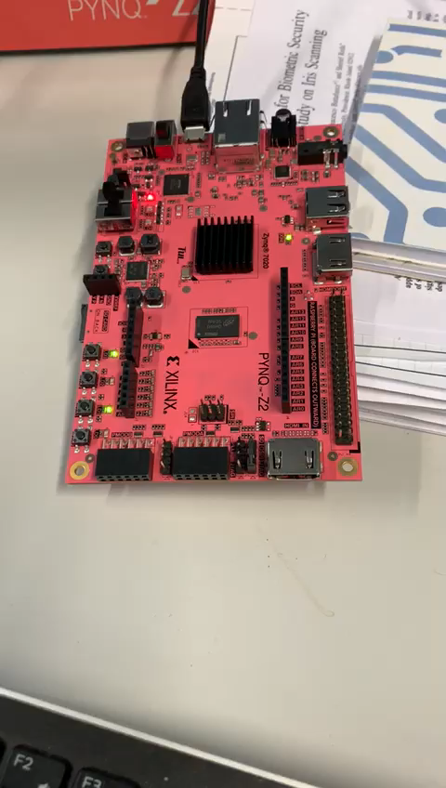
First assignment – Result

Slide 13
Next Verilog Labs
Lab 2-4
Finite State Machines, Mealy and Moore implementations
Design simulation to test functionality
Board implementation to test that the design is correctly working (e.g. debouncing modules)
Lab 5
Linux Driver assignment
Work with the ARM processor in a Linux environment on the Pynq board

